Slide 1



Data Structure
&
Algorithm
Class VIII
lab 13

Slide 2

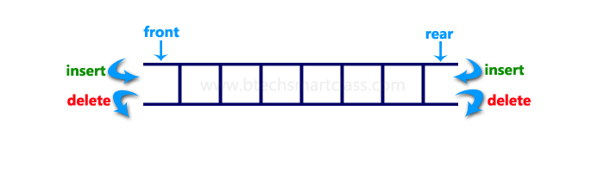
Deque
A deque, also known as a double-ended queue, is an ordered collection of items similar to the queue

Slide 3
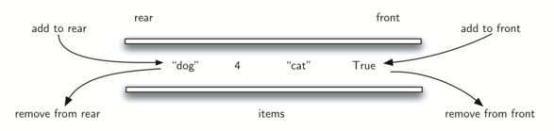
Front/Rear,
It has two ends, a front and a rear, and the items remain positioned in the collection.New items can be added at either the front or the rear

Slide 4
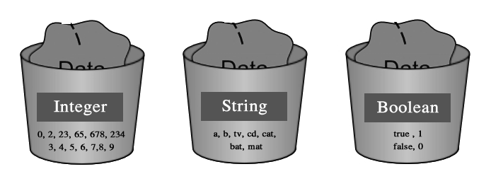
Deque Abstract Data Type
Deque()
addFront(item)
addRear(item)
removeFront()
removeRear()
isEmpty()
size()

Slide 5
Example of Deque
Deque Operation | Deque Contents | Return Value
d.isEmpty() | [] | True
d.addRear(4) | [4]
d.addRear('dog') | ['dog',4,]
d.addFront('cat') | ['dog',4,'cat']
d.addFront(True) | ['dog',4,'cat',True]
d.size() | ['dog',4,'cat',True] | 4
d.isEmpty() | ['dog',4,'cat',True] | False
d.addRear(8.4) | [8.4,'dog',4,'cat',True]
d.removeRear() | ['dog',4,'cat',True] | 8.4
d.removeFront() | ['dog',4,'cat'] | True

Slide 6
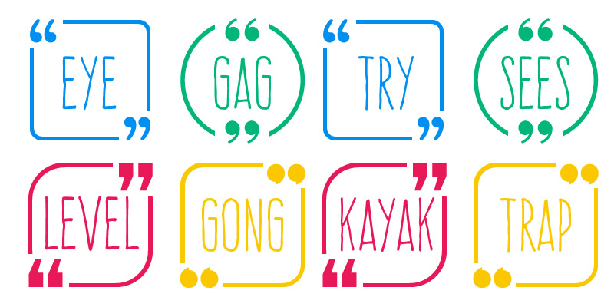
Palindrome
a string that reads the same forward and backward

Slide 7

Lists
a collection of items
where each item holds
a relative position with
respect to the others

Slide 8
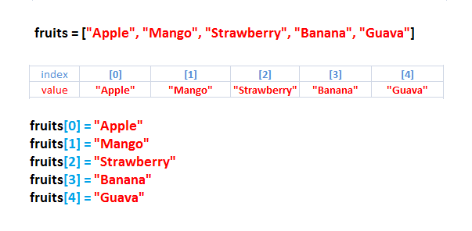
Unordered List Abstract Data Type
List()
add(item)
remove(item)
search(item)
isEmpty()
size()
append(item)
index(item)
insert(pos,item)
pop()
pop(pos)

Slide 9


